Slide 1
Blockchain Based Organ Donation, and Transplant Matching - EtherealHeal
An application by team TrojanX
Soumyadeepta Das
&
Ananya Sajwan
Rakuten Hackathon 2021
Domain: Healthcare

Slide 2
The Problem
Organ trafficking is rampant across the country, with financially weaker people being forced to sell their organs in the black market.
The current organ donation rate in India is one of the lowest in the world and around 5 lakh people die every year due to lack of access to timely organ donation.
It is difficult for patients to find a match and receive organs due to the absence of a proper system, leading to loss of countless lives.
The details of organ donors and patients are not secure and can easily be obtained and tampered with, fuelling organ trafficking.

Slide 3
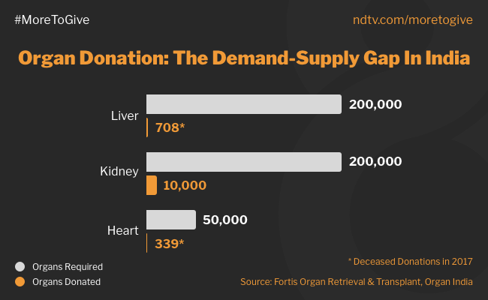
Organ Trafficking
From a study, 305 kidney sellers in 2002
71% were females and the average age was 35 years.
96% of them sold their kidney to pay off debts .
The amount promised for selling a kidney averaged 1,410 USD (range: 450-6,280 USD),
while the amount actually received averaged 1,070 USD (range: 450-2,660 USD).
Of the 292 participants who sold a kidney to pay off debts, 216 (74%) still had debts at the time of the survey.

Slide 4
ORGAN DONATION STATISTICS
Spain
Russia
4.0
46.9
USA
31.96
0.86
India
16.60
Brazil
20.7
Australia
Organ Donation Rate of countries per million people

Slide 5
The Solution – Using Blockchain for Organ Donation, and Transplants
We propose to build a decentralized application for streamlining the organ donation and transplant matching process with the help of Blockchain technology.
The application will connect donors to patients with hospitals acting as a mediator and automates the process using smart contracts.
We will use Ethereum blockchain technology to add traceability, security along with immutability of data and functionality with proper authentication to the organ donation process between donors and recipients.
Act as a much needed fast, decentralized and secure platform to regularize organ donation by connecting hospitals, donors and recipients.

Slide 6
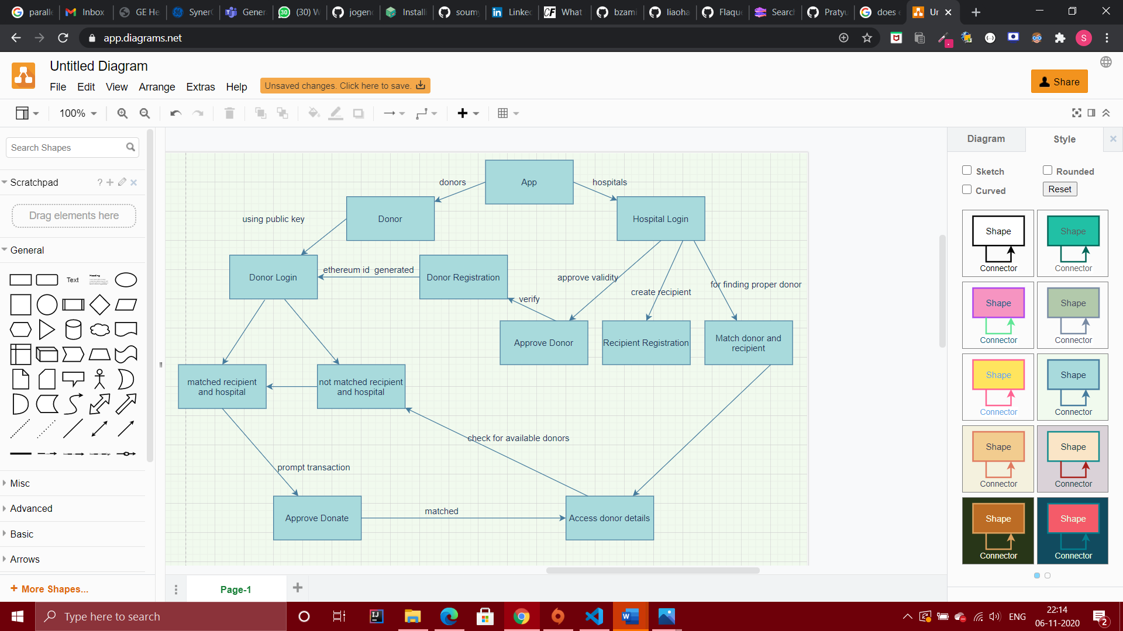
Functional Architecture

Slide 7
FEATURES OF EtherealOrgan
Donor Signup/Login
Donors can signup, upload EMR, enter and view their details and can approach their nearest hospital for approval.
Only approved donors can login using a unique public key, enhancing security of the application.
Donor-Patient Matching
Patients can be matched to the right donors on the basis of blood type and organ/blood requirement.
Once matched, the donor can view details of the hospital and recipient.
Hospital Login
Hospitals can approve donors, and register recipients and match recipients to the approved donors.
EMR Records
Security of EMRs are guaranteed using Ethereum.
EMRs can be accessed using the unique public keys.

Slide 8
TECH STACK
01
02
03
04
Ethereum
MongoDB
Ethereum blockchain technology is used to provide security and maintain a distributed tracking system.
MongoDB is used as the database for the EtherealOrgan application’s hospital details.
React & NodeJS
Ganache
React and NodeJS are used for the frontend and backend of the application respectively.
Developer tools to recreate blockchain environment and test smart contracts.
05
06
Metamask
Solidity
Extension for accessing Ethereum enabled distributed applications, or "Dapps" in your browser
Solidity is an object-oriented, high-level language for implementing smart contracts.

Slide 9
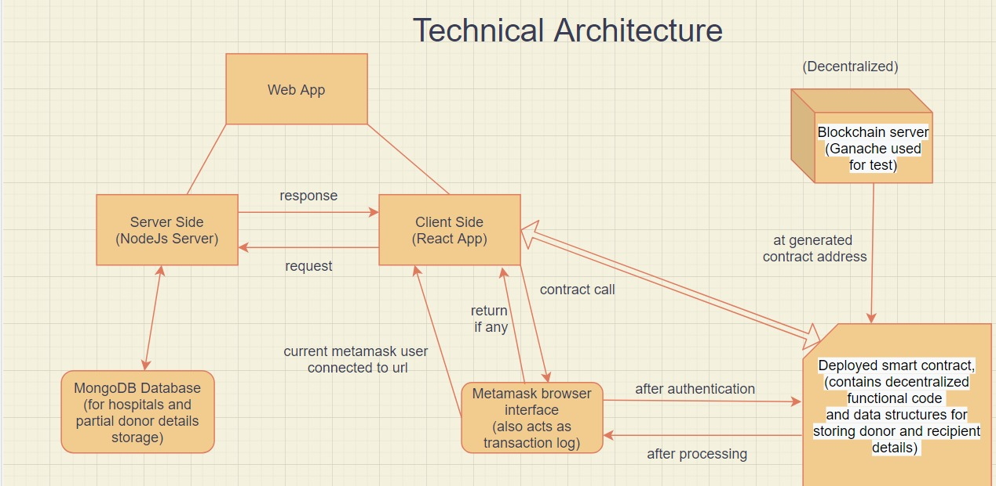
TECHNICAL ARCHITECTURE

Slide 10
WHY BLOCKCHAIN?
Transparency: With blockchain, the organization can go for a complete decentralized network where there is no need for a centralized authority, improving the system’s transparency. A blockchain consists of peers who are responsible for carrying out transactions and validating them.
Security: Security is enhanced by the fact that each node holds a copy of the transactions ever performed on the network. Blockchain networks are also immutable, which means the data, once written, cannot be reverted by any means. This is also the right choice for systems that thrive on immutable data, where one transplant should never be falsified or deleted, and that rules out the question of corruption or denial in payments.
Reduced Costs: Right now, businesses spend a lot of money to improve to manage their current system. That’s why they want to reduce cost and divert the money into building something new or improving current processes. By using blockchain, we can bring down a lot of costs associated with 3rd party vendors. As blockchain has no inherited centralized player, there is no need to pay for any vendor costs. On top of that, there is less interaction needed when it comes to validating a transaction, further removing the need to spend money or time to do basic stuff, and also reduces time delay and human error.
True Traceability: With blockchain, can focus on creating a supply chain that works with both vendors and suppliers. In the traditional supply chain, it is hard to trace items that can lead to multiple problems, including theft, counterfeit, and loss of goods. With blockchain, the supply chain becomes more transparent than ever.

Slide 11
WHY BLOCKCHAIN?
Improved Speed and Highly Efficient: The last industrial benefit that blockchain brings is improved efficiency and speed. Blockchain solves the time-consuming process and automates them to maximize efficiency. The streamlining and automation of processes also mean that everything becomes highly efficient and fast. The decentralized architecture could be used by the organization to distribute further and scale both horizontally and vertically, and on each node a lesser load.

Slide 12
Advantages of this solution
Organized and more available to the end users:
Will help the donors, recipients, and healthcare organization come together in a single holistic platform, making the process more available to the users, reducing middlemen, fraud, and trafficking.
Robust, Secure and Traceable system:
Blockchain adds traceability, security along with immutability of data and functionality with proper inbuilt authentication to the organ donation process between donors and recipients.
Timely access to transplant:
Instead of manually looking up for or finding suitable transplant matches, it will automate the process. Due to this, instant and automated matching of organ transplants, it more efficient and fast.
Automation:
To an extent where IOT and healthcare devices could be integrated using smart contracts, and made to be work like a whole workforce in itself.
Creating a universal secure patients profile: Could be used for faster and proper healthcare availability and improving diagnostics, could be used to improve patient experience and for research.

Slide 13
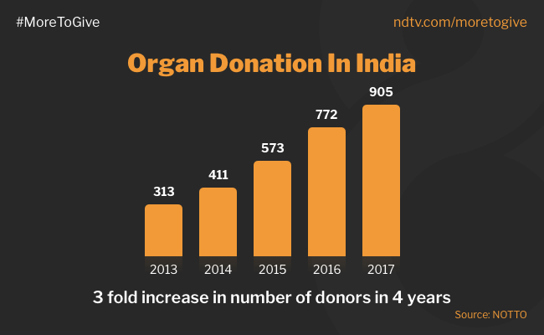
MARKET SCOPE
Blockchain has been around for 10 years and is immensely popular in trading and is currently being widely used for software development.
Organ donation platforms using blockchain currently only exist on research papers and have not been functionally implemented yet, thus leaving potential for deployment of a working implementation in the healthcare sector. Almost zero competitors.
The healthcare sector in India around the world is in dire need of a secure application for streamlining organ donation, and our solution aptly does so. High demand for such solution.

Slide 14
REVENUE
Main source of revenue will be generated from the hospitals in the form of a membership or subscription fee which could be one-time or regular. (Approximately 70k hospitals are there in India.)
The application will be free for donors and recipients to register.
As this will provide hospitals easy, fast and secure automatic filekeeping and one-click transplant match saving labour, time and enhancing security, this will be a ideal product.
Consumers will be hospitals and similar healthcare organizations.
Users of the application will include donors, recipients, hospitals and admins.

Slide 15
FUTURE SCOPE
EMR details extraction using AI. Using details for further research and creating an universal patient record platform.
Enhanced filters and factors for matching. And further automation on when a person wants to domain and triggers.
Integration with IOT healthcare devices to automate further workflows and tasks. Like Insurance Claims, Drug Administration, etc.
The architecture could be continuously distributed for supporting more and more and users easily.
Advanced search features for hospitals to search for specific donors and recipients and match according to requirement manually.

Slide 16


TEAM TrojanX
Ananya Sajwan
(VIT Chennai)
Soumyadeepta Das
(VIT Chennai)

Slide 17
THANK YOU!
Team TrojanX

